Slide 1
Presentation and visualization
2020-September. Rules of the game
Mireia Ribera ribera@ub.edu

Slide 2

Rules of the game

Slide 3

Practical information
Timetable: Live sessions, Thursday 16-17 p.m.
+1h assynchron Contents at Google Drive but videos may require sign-in in campus virtual
Deliveries at Campus Virtual
Notes:
Icons by Freepik from Flaticon [https://www.flaticon.com/]

Slide 4

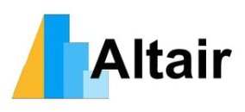

Goals
To know theoretical foundations of information visualization
To learn the basics of a visualization library
To be able to select the best visualization for a specific data, task and user

Slide 5

Class organization
Flipped classroom contents are explained asynchronously Live sessions to share, work in groups or practice.

Slide 6

Evaluation
Dashboard task
Storytelling task
Teams of 2-3 people
Presented in public
Including report on decisions, methods...
40% of final qualification, each
Final exam
Both theoretical questions and practical exercises
20% of final qualification

Slide 7

About me
Computer science + Information science background
Interests in HCI, user experience, accessibility and information visualization
I expect your active participation

Slide 8

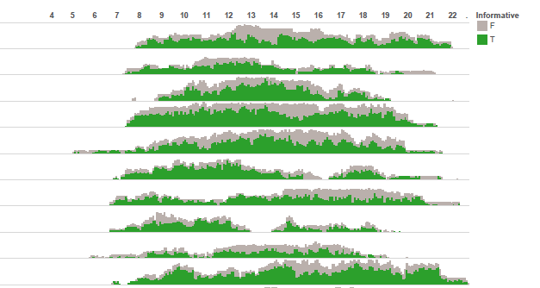
Some projects: wearable camera exploration study

Slide 9
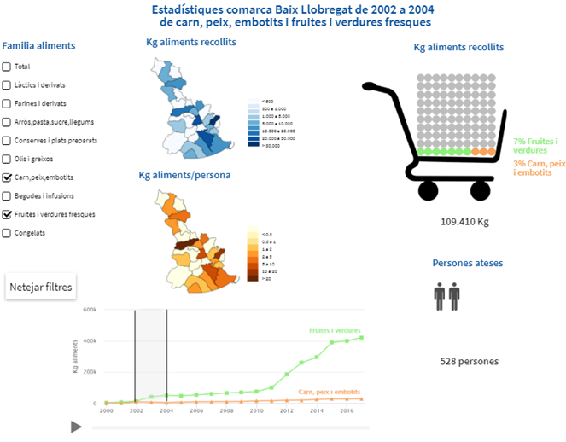
Projects II: banc dels aliments

Slide 10
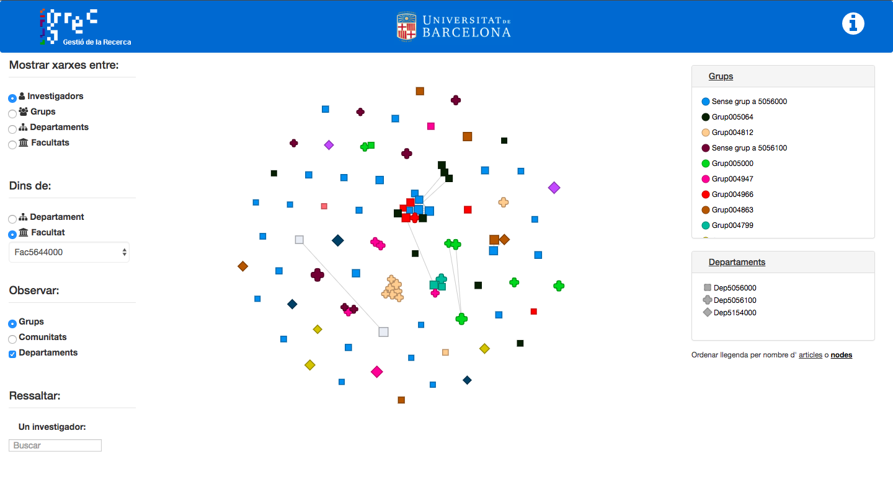
Projects III: Scientific networks @ UB

Slide 11
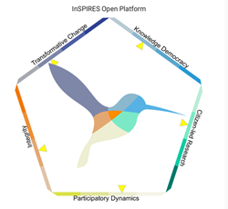
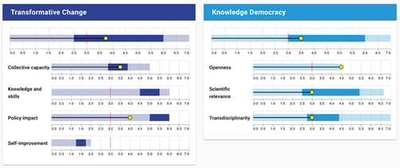
Projects IV: Inspires platform

Slide 12

What about you?
Background?
Previous experience?
Do you like / dislike a specific visualization?
What do you expect from this class?

